Slide 1


Hoạch định nguồn lực doanh nghiệp ERP
Trình bày: GV Đỗ Duy Thanh

Slide 2
Nội dung của phần quy trình trong ERP
Dự báo & lập kế hoạch sơ bộ
Bán hàng & phân phối
Sản xuất
Vật tư & Kho bãi
Kế toán trong Logistics

Slide 3
Part 4 Quản trị vật tư (Material Management) Quản trị kho (Warehouse Management)

Slide 4
4A. Material Management

Slide 5
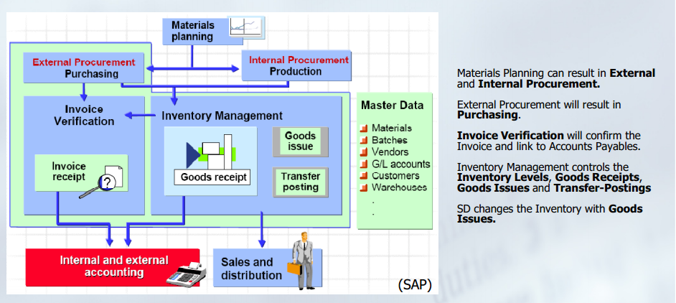
Overview of Material Management
Procurement by
Purchasing or
Produce or
Replenishment

Slide 6
Main functions
Two main block : Purchasing + Inventory Management.
Detail:
Purchasing:
Invoice Verification – Xác thực hóa đơn
Purchasing – Mua hàng
Inventory:
Inventory Management (Good receipt, Internal Good Movement, Good Issue)
Product Catalogs – Danh mục hàng hóa
MRP integration
Physical Inventory – Kiểm kê
Valuation – Định giá

Slide 7
4A.1 Purchasing
Purchase Master Data
Purchase Processes
Question?

Slide 8
Procurement to pay
Yêu cầu
Báo giá
Chọn lựa
Nhà cung cấp
Yêu cầu
mua hàng
Tạo đơn mua hàng
Thông báo đến nhà cung cấp
Thanh toán
Cho nhà cung cấp
Vận chuyển
Từ nhà cung cấp
Xác thực
Hóa đơn mua hàng
Nhận hàng

Slide 9
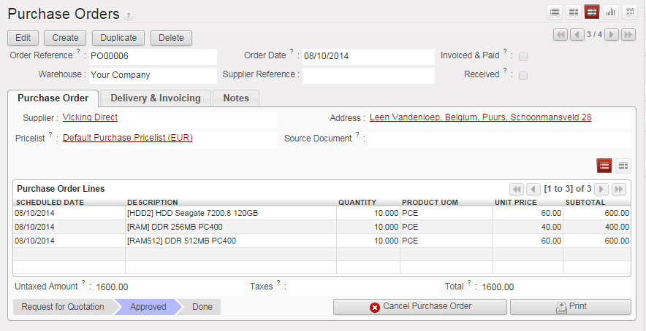
Master Data
Purchase Master Data
Purchase Processes
Question?
Price List
Partner Master Data
Material Master Data

Slide 10
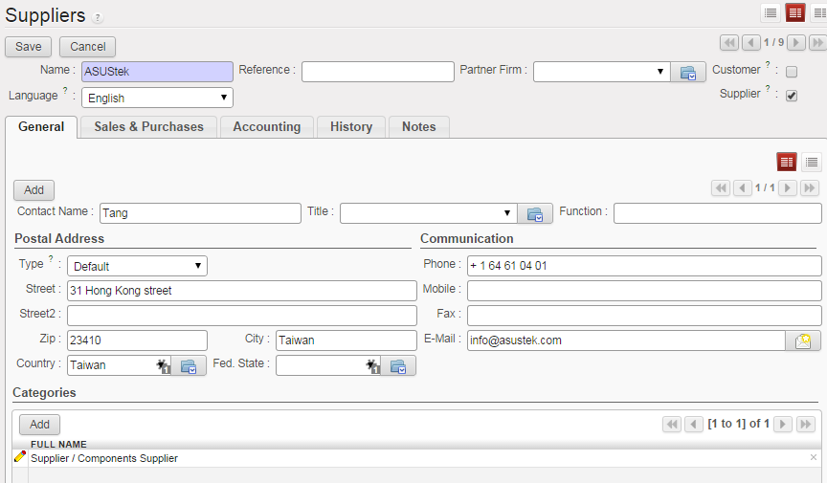
Vendor Master Data
Vendor Master
Contains all the necessary information needed to business with an external supplier
Used and maintained primarily by the Purchasing and Accounting Departments
Purchase Master Data
Purchase Processes
Question?

Slide 11
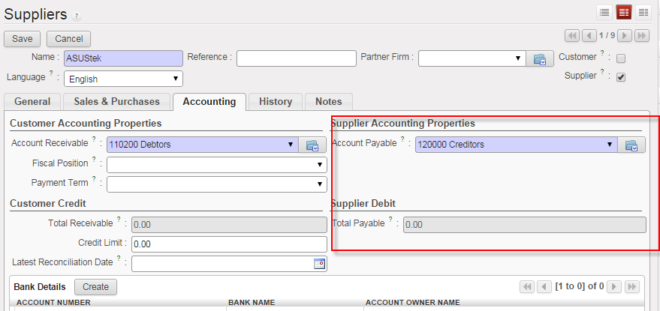
Vendor Master Data with Accouting
Account payable
Supplier Debit
Purchase Master Data
Purchase Processes
Question?

Slide 12
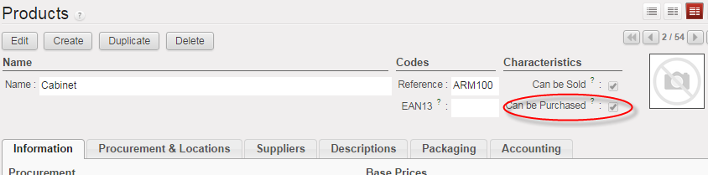
Material Master Data
Purchase Master Data
Purchase Processes
Question?
Can be purchased

Slide 13
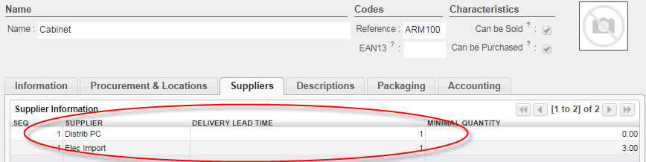
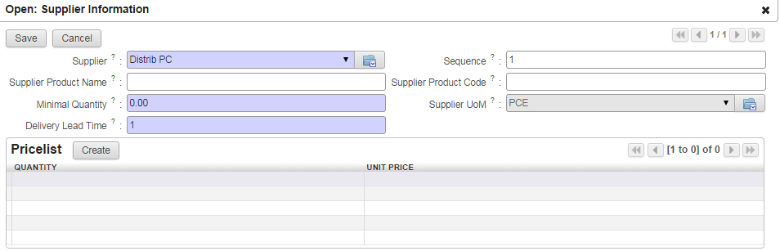
Material Master Data (cont)
Purchase Master Data
Purchase Processes
Question?
Supplier with price list and min ordered quantity, Delivery lead time..

Slide 14
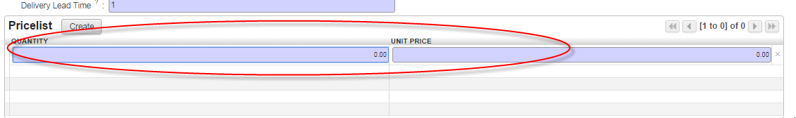
Price list
Purchase Master Data
Purchase Processes
Question?
In openERP, price list concept is the same for both Sale & Purchasing
Difference in configuration at the customer & supplier price list specification
Purchase: could be defined at Material Master Data.
Sale: create customer price list specification

Slide 15
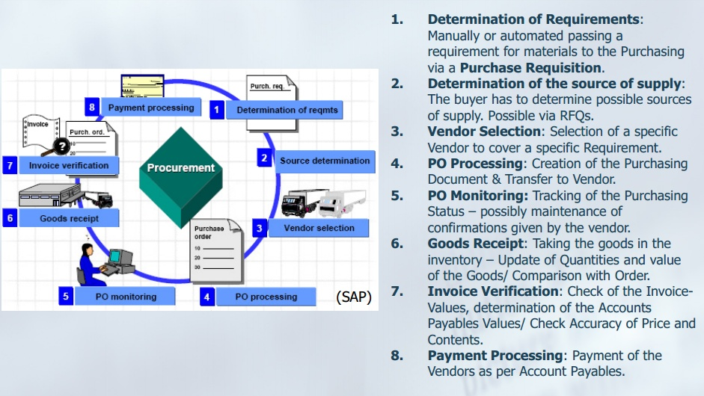
Purchasing overview
Why do we need purchasing? What is the trigger of the purchasing?

Slide 16
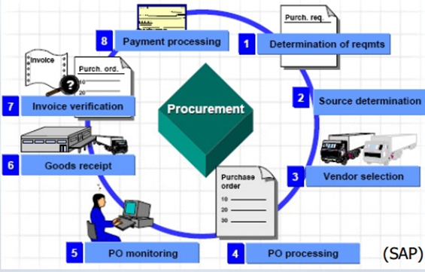
In OpenERP processes
Purchase Requisition
Vendor Evaluation
Purchase Order Processing
Purchase Order Monitoring
Good Receipt
Invoice Verification
Payment
RFQ
. Install Purchaser Requisition module
Transaction data:
Purchase Requisition
RFQ
Purchase Order
Incoming Shipment
Invoice

Slide 17
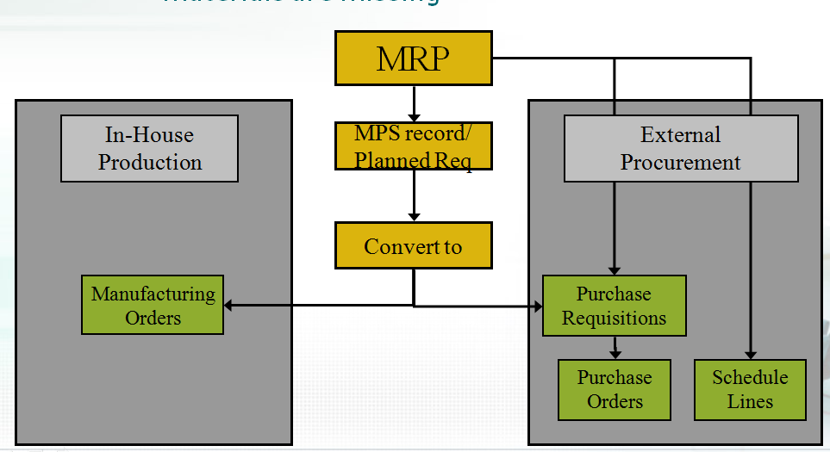
Purchase Requistion
Puchase Requistion
RFQ
Vendor Evaluation
Purchase Order Processing
Purchase Order Monitoring
Good Receipt
Invoice Verification
Payment
Internal Document instructing the purchasing department to request a specific good or service for a specified time
Requisitions can be created two ways:
Directly - Manually
person creating determines: what, how much, and when
Indirectly - Automatically
MRP
Production Orders
Maintenance Orders
Sales Orders
Version 6, purchase requisition is just for Manual Purchasing and Tender
Version 7, full integration with MRP, Production Orders
Notes:
PR = phiếu yêu cầu vật tư

Slide 18
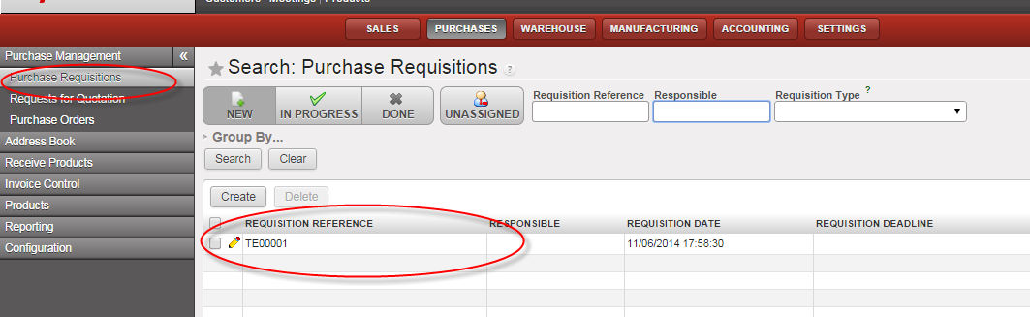
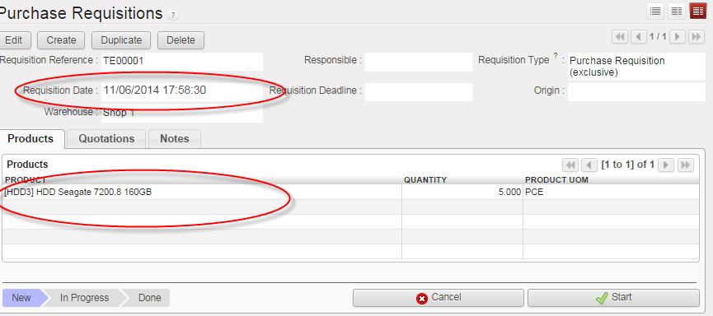
Purchase Requistion
Puchase Requistion
RFQ
Vendor Evaluation
Purchase Order Processing
Purchase Order Monitoring
Good Receipt
Invoice Verification
Payment

Slide 19
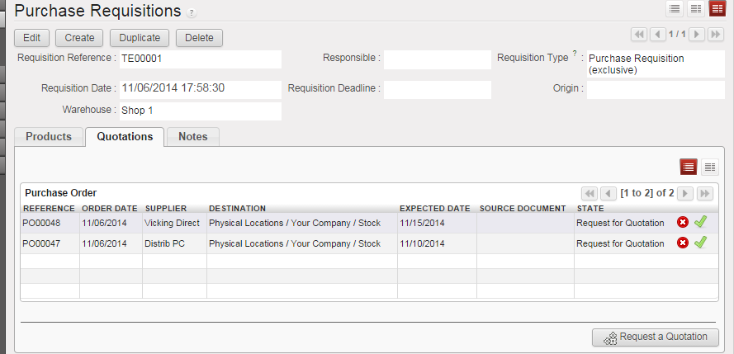
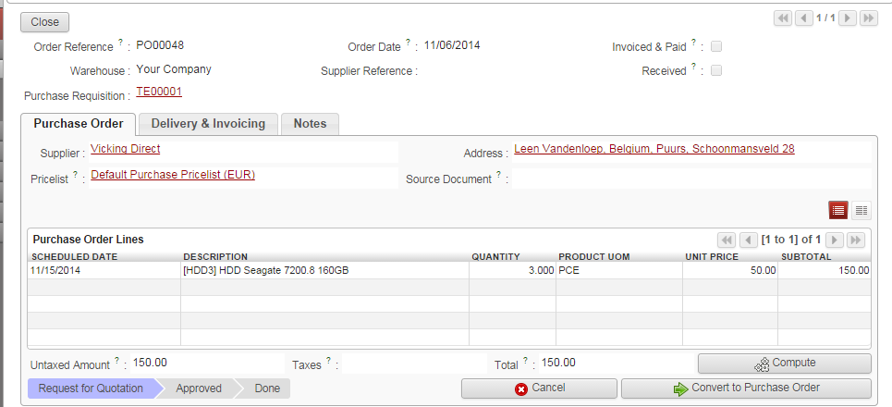
Purchase Requistion
Puchase Requistion
RFQ
Vendor Evaluation
Purchase Order Processing
Purchase Order Monitoring
Good Receipt
Invoice Verification
Payment
Create and group all RFQ->>> Tender
Notes:
PR

Slide 20
Request for quotation - RFQ
Puchase Requistion
RFQ
Vendor Evaluation
Purchase Order Processing
Purchase Order Monitoring
Good Receipt
Invoice Verification
Payment
An RFQ is an invitation for a vendor to submit a bid for the supply of materials or services
Purchase Requistion
RFQ 2
Vendor 1
RFQ 2
RFQ 3
Vendor 3
Vendor 2
Evaluation
Purchase Oder
Purchase Oder
Purchase Oder

Slide 21
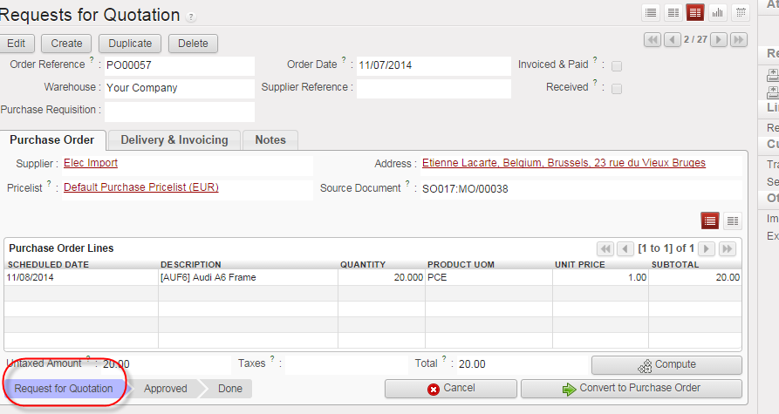
Request for quotation - RFQ
Puchase Requistion
RFQ
Vendor Evaluation
Purchase Order Processing
Purchase Order Monitoring
Good Receipt
Invoice Verification
Payment

Slide 22
Vendor Evalution – Missing part in OpenERP
Puchase Requistion
RFQ
Vendor Evaluation
Purchase Order Processing
Purchase Order Monitoring
Good Receipt
Invoice Verification
Payment
Vendor evaluation helps purchasing evaluate vendors for sourcing while also enabling the company to monitor vendor relationships through performance scores and criteria you put in place.
Price
Price Level
Price History
Quality
Goods Receipt
Quality Audit
Complaints/Rejection level
Delivery
On-time delivery performance
Quantity reliability
Compliance with shipping instructions
Confirmation Date
You then must establish a scoring range (1 -100) and determine the weight factors of scores for each.

Slide 23
Purchase Order Processing
Puchase Requistion
RFQ
Vendor Evaluation
Purchase Order Processing
Purchase Order Monitoring
Good Receipt
Invoice Verification
Payment
A purchase order is a formal request to a vendor for a specific material or service under the stated conditions
Purchase Orders can be created manually
Reference a Purchase Order
Reference a Purchase Requisition
Reference a RFQ/Quotation
Without Reference
Purchase Orders can be create automatically

Slide 24
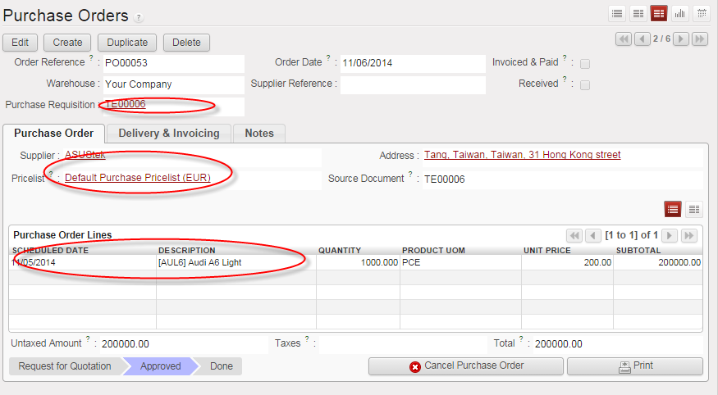
Purchase Order Processing
Puchase Requistion
RFQ
Vendor Evaluation
Purchase Order Processing
Purchase Order Monitoring
Good Receipt
Invoice Verification
Payment
PO is the main Transaction Data in Purchasing
Once a Purchase Order has been created the vendor needs to be notified
Printed
E-mail
EDI
Fax
XML
There are a variety of forms that aid in the purchasing process and are generated from the Purchase Order
Purchase Order Output
Order Acknowledgement Forms
Reminders
Schedule Agreements

Slide 25

Good Receipt - GR
Puchase Requistion
RFQ
Vendor Evaluation
Purchase Order Processing
Purchase Order Monitoring
Good Receipt
Invoice Verification
Payment
Charge of Warehouse Manager/ Controller
Purchase
Order
45......01
Notify Vendor
Vendor
Goods Receipt
Shipment

Slide 26
Good Receipt - GR
Puchase Requistion
RFQ
Vendor Evaluation
Purchase Order Processing
Purchase Order Monitoring
Good Receipt
Invoice Verification
Payment
Goods movement in which we accept goods into our system
If materials are delivered against a Purchase Order we will reference that Order
Determine if we got what we ordered
System can purpose data for us from the PO
Material, quantity
Purchase Order History is update with the receipt
Updates Physical Inventory
Updates Inventory G/L Account
Receiving and put away video : http://www.youtube.com/watch?v=ZN6--Xi5lKo
How can we do that?
Reference code in Outbound Delivery Note of Vendor
Notes:
Reference code in Outbound Delivery Note of Vendor (carried by the Driver – or in Bill of Lading (vận đơn))

Slide 27
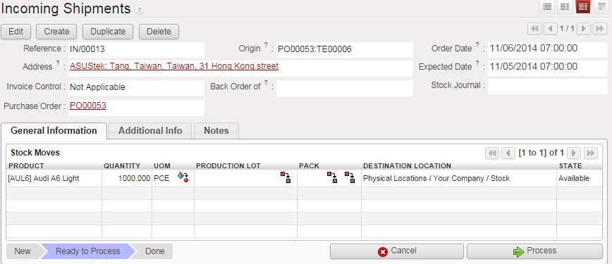
Good Receipt - GR
Puchase Requistion
RFQ
Vendor Evaluation
Purchase Order Processing
Purchase Order Monitoring
Good Receipt
Invoice Verification
Payment
Inbound Delivery – Incoming Shipment is used for receiving with reference to PO

Slide 28
Good Receipt Effection
Puchase Requistion
RFQ
Vendor Evaluation
Purchase Order Processing
Purchase Order Monitoring
Good Receipt
Invoice Verification
Payment
When a Goods Movement for the receipt of goods takes place a series of events occur
Accounting Document is Created (Draft Supplier Invoice )
Stock Quantities are Updated
Stock Values are Updated
Purchase Order is Updated (status)
Output can be generated (GR slip / pallet label)

Slide 29
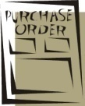
Invoice Verification
Puchase Requistion
RFQ
Vendor Evaluation
Purchase Order Processing
Purchase Order Monitoring
Good Receipt
Invoice Verification
Payment
Incoming Invoices are reference against a Purchase Order to verify their content, prices, and arithmetic.
If discrepancies arise between the purchase order or goods receipt and the invoice the system with generate a warning or an error
Purchase order
- Target quantity
- Target price
Invoice receipt
- Actual price
Goods receipt
- Actual quantity

Slide 30
Invoice Verification
Puchase Requistion
RFQ
Vendor Evaluation
Purchase Order Processing
Purchase Order Monitoring
Good Receipt
Invoice Verification
Payment
When an invoice is saved it applies the liability from the Goods Receipt of our Purchase Order to a Vendor
Upon verification the:
Purchase Order is updated
Material Master is Updated (MAP)
Accounting Document is created
Once the Invoice has been posted the verification process is completed and the payment process is initiated within Financial Accounting

Slide 31
Payment
Puchase Requistion
RFQ
Vendor Evaluation
Purchase Order Processing
Purchase Order Monitoring
Good Receipt
Invoice Verification
Payment
Can be done automatically or manually
Post Outgoing Payment vs. Payment Program
Elements of the Payment Transaction:
Payment Method
Bank from which they get paid
Items to be Paid
Calculate Payment Amount
Process will create a financial accounting document to record the transaction

Slide 32
Review Production Strategies MTS & MTO with Oder point rule

Slide 33
Order Point rule for Procurement
Supply\ Proc | MTS Trigger is Forecast and Sale Demand (SO) | MTO Trigger is Sale Demand and Dependent Requirement | Company type
Buy | Check Stock first (warning if not enough) When not enough in stock -> Buy Buy with manual quantity (MPS) Buy with Re-Order Point ->Purchase Order creation with consideration of Oder Point Rule | Don’t check Stock (because we don’t stock it before hand) -> Buy Buy with manual quantity (MPS) Buy with Re-Order Point ->Purchase Order creation with the number = need (w/o OP rule) or Order Point consideration | Thương mại
Produce | Check Stock first (warning if not enough) When not enough in stock -> Produce -> Production Order & Purchase Order for missing part(manufacturing Order) | Don’t check Stock (because we don’t stock it before hand) -> Produce -> Production Order & Purchase Order for missing part (manufacturing Order) | Có sản xuất hoặc lắp ráp

Slide 34
Order Point rule for Procurement (cont) BUY - MTO
Sale Oder quantity = 20
Stock = 17
MTO & Buy – without Order Point
When MRP run -> Buy -> Purchase Order creation
Number of purchase Quantity =
MTO & Buy – with Order Point rule (0,20)
When MRP run -> Buy -> Purchase Order creation
Number of purchase Quantity =
Sale Order Quantity
Sale Oder Quantity
+ Stock fulfillment (Oder Point) =
20 + 3= 23

Slide 35
Order Point rule for Procurement (cont) BUY- MTS
Sale Oder quantity = 55 ->warning
Stock = 40
MTO & Buy – without Order Point
When MRP run -> Buy -> Exception
MTO & Buy – with Order Point Rule (0,45)
When MRP run -> Buy -> Purchase Order creation
Number of purchase Quantity =
Sale Oder Quantity
+ Stock fulfillment (Oder Point) =
55 + 5 = 60

Slide 36
Order Point rule for Procurement (cont) Produce- MTO
Sale Oder quantity = 50
Stock = 45
MTO & Produce– with or without Order Point
When MRP run -> Produce-> Manu. Orders creation
-> Purchase Order for Missing part
Number of Produced Quantity =
In basic of OpenERP 6 doesn’t support Manufacturing with Stock Consideration
In Logic, system must consider stock at least like Order point rule like Buying
2 MO, and purchase orders
Sale Order Quantity =50

Slide 37
4A.2 Inventory Management

Slide 38
Inventory Management - Main function
Inventory Management (Good receipt, Internal Good Movement, Good Issue)
Product Catalogs – Danh mục hàng hóa
Inventory report
MRP integration
Physical Inventory – Kiểm kê
Valuation – Định giá

Slide 39
Good receipt, Internal Good Movement, Good Issue
Receipt from Purchasing or Replenishment
Issue to customer or for Replenishment
Internal Movement: for Production
Replenishment: stock movement from plant to plant

Slide 40
Final Concept of Procurement
Balancing Collision btw Sale Forecast, Sale Order on hand, Stock, Planned Production, Producing, Replenished Production
 | T1 | T2 | T3 | T4
Sale Forecast
Sale Order
Stock
Planned Production | Số sản phẩm cần sản xuất (hoạch định)
Producing | Số sản phẩm đang sản xuất
Replenished Production | Số sản phẩm cần sản xuất thêm
Demand Management From beginning
Notes:
Re

Slide 41
Final Concept of Procurement(cont)
Now
 | T1 | T2 | T3
Forecast | 10 | 10 | 12
SO | 2 | 0 | 1
Stock | 10 | ? | ?
Planned Production | 10 | ? | ?
Producing | 0 | ? | ?
Replenished Production | 0 | ? | ?
Notes:
Re

Slide 42
 | T1 | T2 | T3
Dự báo | 10 | 10 | 12
Đơn hàng đã có | 2 | 0 | 1
Tồn kho | 10 | ? | ?
Planned Production | ? | ? | ?

Slide 43
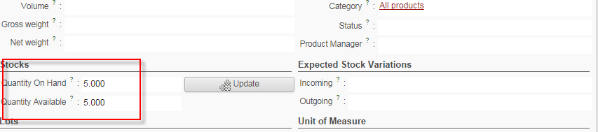
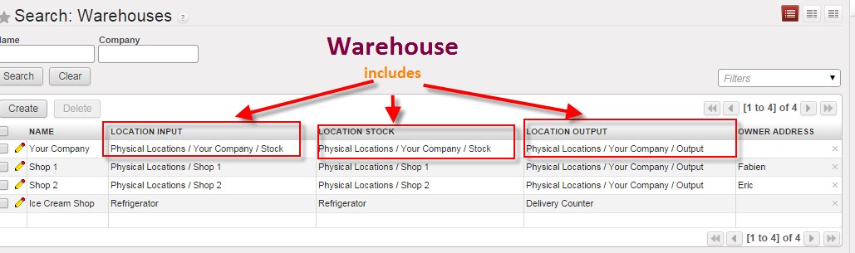
Organization structure Stock & Warehouse & Location in OpenERP
Stock means quantity and value
Warehouse & location mean the physical position

Slide 44
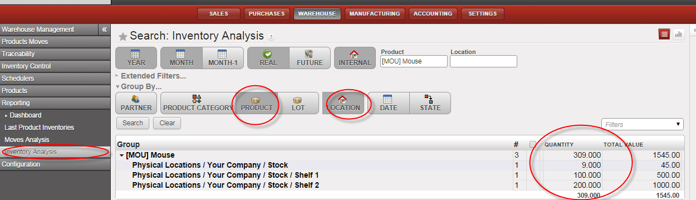
Stock – Product by Location

Slide 45
Business cases
Công ty CP ABC bán xăng, có 3 cây xăng ở Ninh Thuận, Bình Dương, Hồ Chi Minh. Hai loại sản phẩm là A95, A92.
Ngày 1 mua 2000 lit A92, 3000 lit A95, từ kho Nhà Bè của Petrolimex. Phân phối ra kho
Bình Dương (500 A92, 500 A95)
Ninh Thuận (1000 A92, 1000 A95)
Hồ Chí Minh (500 A92, 1000 A95)
Ngày 2 xuất bán Ninh Thuận 200 A92, Bình Dương 300 A95, Hồ Chí Minh 400 A95.
Cách tổ chức cấu trúc kho của công ty phải làm sao để trả lời các vấn đề sau:
Tổng số xăng A92, A95 của công ty và các kho là bao nhiêu
ABC
Ninh Thuận
Bình Dương
HCM

Slide 46
Maybe????
ABC do Good issue to customer in Ninh Thuận will use which stock?
ABC
Warehouse
Location
(2000 A92, 3000A95)
Warehouse
Stock
New (1800 A92, 1800A95)
(1000 A92, 1000 A95)
(500 A92, 1000 A95)
(500 A92, 500 A95)
Stock
Binh Dương
Stock
Ninh Thuận
-200 A92
Stock
HCM
-400 A95
-300 A95
New (500 A92, 200 A95)
New (800 A92, 1000 A95)
New (500 A92, 600 A95)
Input
Bình Duong
Input
Ninh Thuận
Input
HCM
(500 A92, 500 A95)
(1000 A92, 1000 A95)
(500 A92, 1000 A95)

Slide 47
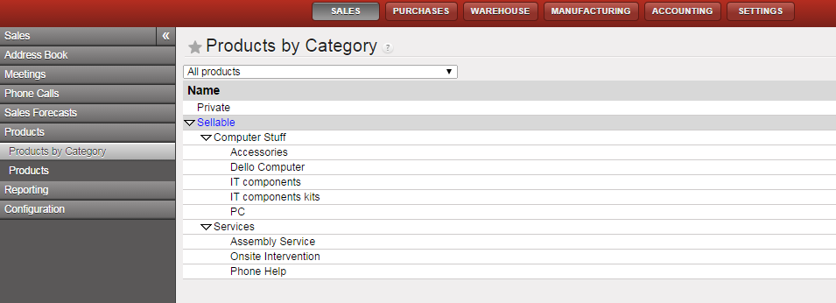
Product Catalogs

Slide 48
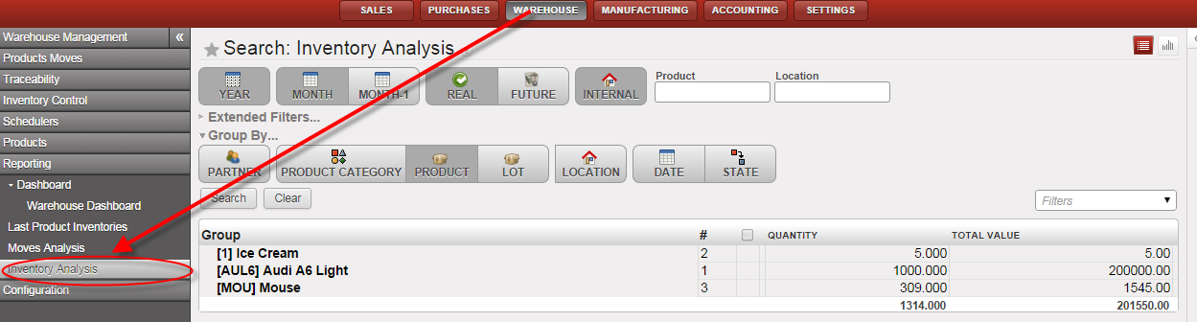
Inventory Report
Bác cáo tồn kho theo sản phẩm, danh mục sản phẩm, theo tháng, năm, tương lai…

Slide 49
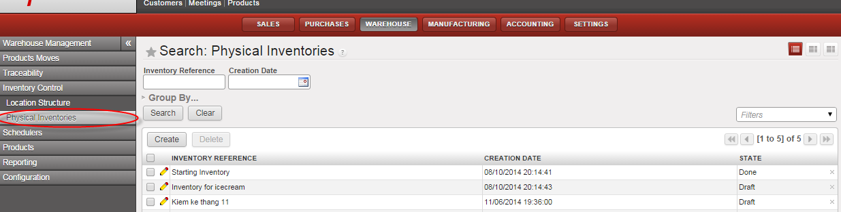
Physical Inventory
Kiểm kê
Why? Since the asynchronous of Information System with Physical Status by Mistakes, Loss, Damage….

Slide 50
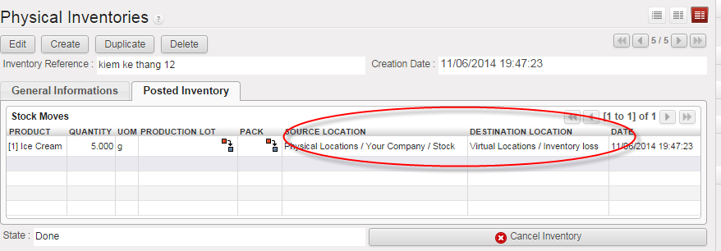
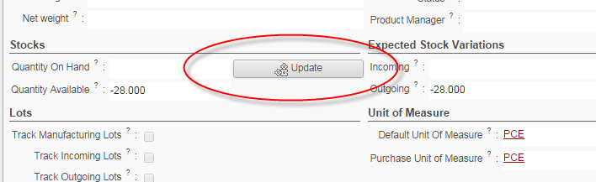
Physical Inventory (cont)
Or

Slide 51
Valuation function
Answer the “Product Value” question?
Link with the Accounting & FI module

Slide 52
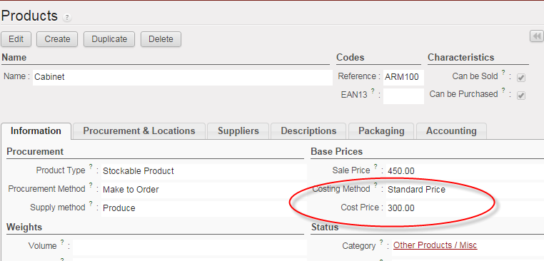
Valuation - Cost Price
How much of you stock value is?
Average
Standard

Slide 53
Link MM & WH with FI
Goods Receipt
Invoice Receipt
Payment Program
AP (Vendor)
Inventory
GR / IR
Bank
Dr Cr
Dr Cr
Dr Cr
Dr Cr
$100
$100
$100
$100
$100
$100
More detail in Accounting module

Slide 54
4A. Warehouse Management

Slide 55
Concept
Material Management | Warehouse Management
Quantity + Value | Quantity + Location
Purchasing Inventory Management | Extension of Inventory Management: More detail in Location (Bin, Quant, packing unit, Lot or Batch Management)
Small Company without caring about Warehouse Organization | Medium and Big company with multiple product and size In openERP 6: Packing uit Management Lot Management

Slide 56
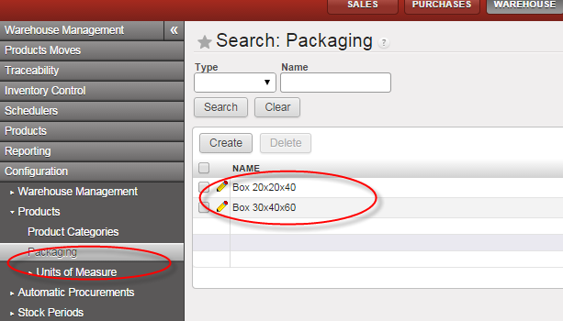
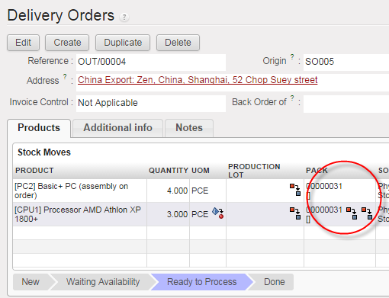
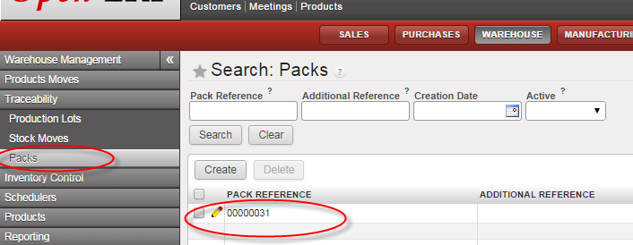
Packing Unit - In OpenERP
Packing Unit

Slide 57
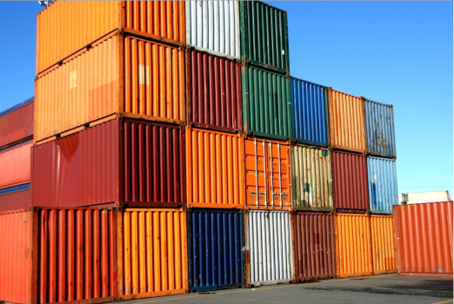
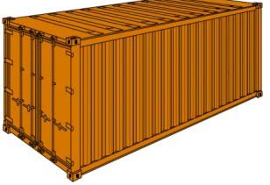
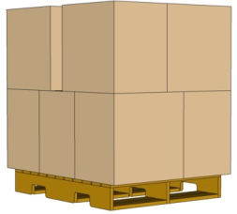
Lot in OpenERP
Production lots (batch numbers) are represented by a unique product or an assembly of identical products leaving the same production area. They are usually identified by bar codes stuck on the products. The batch can be marked with a supplier number or your own company numbers.
One batch could have many packing units.
Batch (lot)
Packing Unit
Products
1-n
1-n

Slide 58
Traceability of Pack and Lot
Upstream Traceability: from supplier through to customers,
Downstream Traceability: from customer back to suppliers,
Customer 1
Supplier
Company
Customer 2
Notes:
Upstream: s – company – customer & customer
Downstream: customer 1 – company supplier

Slide 59
Summary
Purchasing Process
Inventory Management:
Valuation + Integration with FI
Mini Warehouse with traceability by packing unit and lot
MM is about quantity and value
Warehouse is about quantity and location

Slide 60
Câu hỏi?

